Slide 1
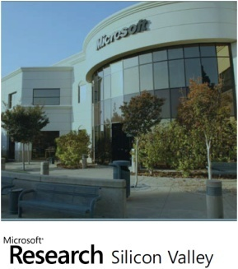
The Lincoln Project Building a Web-Scale Semantic Search Engine
John Shafer
Search Labs, Microsoft Research
JIWES 2012
Notes:
This deck describes collaborative work involving all members of Search Labs.
See paper citations for specific attributions

Slide 2
Lincoln Project Summary
Lincoln Runtime
Index of nearly 30 million products
Classification of a query into multiple categories at “right” level of taxonomy
Semantic understanding of query in terms of product attributes
Ranking incorporating intelligent back-off and fuzzy structure-aware ranking
Familiar UI that seamlessly integrates browsing and search
Lincoln Catalog
Web-scale entity catalog of ~30 million products and ~30 million offers
Type normalization, key attributes identification, equivalent attributes
Classification of products/offers to taxonomy
Automated matching of offers to products
Synthesize new products from unmatched offers
Decision aides
Price forecasting and histories to help decide when to buy
Clipboard for saving and comparing results, Multiple result renderings, …

Slide 3
Lincoln-related Papers
Query Processing
S. Paparizos, A. Ntoulas, J. Shafer, and R. Agrawal. “Answering web queries using structured data sources”. SIGMOD’09
A. Fuxman, A. Kannan, A. Goldberg, R. Agrawal, P. Tsaparas, and J. Shafer. “Improving Classification Accuracy Using Automatically Extracted Training Data”. KDD’09
T. Cheng, H. Lauw, S. Paparizos. "Fuzzy Matching of Web Queries to Structured Data". ICDE’10
N. Sarkas, S. Paparizos, P. Tsaparas. "Structured Annotations of Web Queries". SIGMOD’10
S. Gollapudi, S. Ieong, A. Ntoulas, S. Paparizos. "Efficient Query Rewrite for Structured Web Queries". CIKM’11
J. Pound, S. Paparizos, P. Tsaparas. "Facet Discovery for Structured Web Search: A Query-log Mining Approach". SIGMOD’11
S. Bhattacharya, S. Gollapudi, K. Munagala. "Consideration Set Generation in Commerce Search". WWW’11
S. Gollapudi, D. Panigrahi. "Result Enrichment in Commerce Search using Browse Trails". WSDM’11
S. Gollapudi, S. Ieong, A. Kannan. "Structured Query Reformulation in Commerce Search". CIKM’12
S. Ieong, N. Mishra, Or Sheffet. "Predicting Preference Flips in Commerce Search". ICML’12
Web
R. Agrawal, A. Fuxman, A. Kannan, J. Shafer, P. Talukdar. "Associating Structured Records To Text Documents". (Poster) WWW’12
Catalog Creation
P. Papadimitriou, P. Tsaparas, A. Fuxman, L. Getoor. "TACI: Taxonomy Aware Catalog Integration". TKDE’10
A. Kannan, P. Talukdar, N. Rasiwasia, Q. Ke. "Improving product classification using images". ICDM’11
A. Kannan, I. Givoni, R. Agrawal, A. Fuxman. "Matching Unstructured Offers to Structured Product Descriptions". KDD’11
E. Gonina, A. Kannan, J. Shafer, M. Budiu. "Parallelizing large-scale data processing applications with data skew: a case study in product-offer matching". MAPREDUCE’11
H. Nguyen, A. Fuxman, S. Paparizos, J. Freire, R. Agrawal. "Synthesizing Products for Online Catalogs". VLDB’11
A. Bakalov, A. Fuxman, P. Talukdar, S. Chakrabarti. "SCAD: Collective Discovery of Attribute Values". WWW’11
Decision Aids
Y. Lu, P. Tsaparas, A. Ntoulas, L. Polanyi. "Exploiting Social Context for Review Quality Prediction". WWW’10
R. Agrawal, S. Ieong, R. Velu. "Timing When to Buy". CIKM’11
R. Agrawal, S. Ieong, R. Velu. "Ameliorating Buyer's Remorse". KDD’11
P. Tsaparas, A. Ntoulas, E. Terzi "Selecting a Comprehensive Set of Reviews". KDD’11
S. Jagabathula, N. Mishra, S. Gollapudi. "Shopping for Products You Don't Know You Need". WSDM’11
R. Agrawal, S. Ieong. "Aggregating Web Offers to Determine Product Prices". KDD’12
http://research.microsoft.com/en-us/groups/searchlabs/pubs.aspx

Slide 4
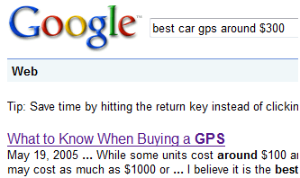
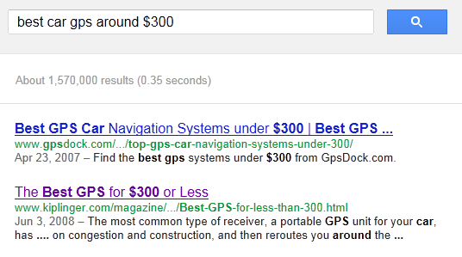
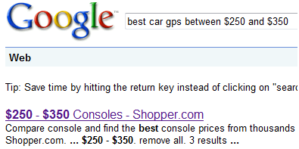
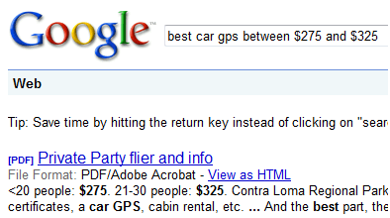
Best Car GPS around $300
Game Consoles
Party Site
Finance Publisher
As Seen on August 13, 2012
As Seen on July 12, 2009
Notes:
What entity search looked like in 2009, when we started, and today
Aside from named entity queries, entity search is poor
Queries treated as undistinguished keywords, no semantic understanding
Occasionally, results may look good on surface, but it is from deep in the tail – not best content
To be clear, web does have highly relevant content – but search cannot find it with simple token matching (search is failing, not the data)
Search in entity portals even worse…

Slide 5
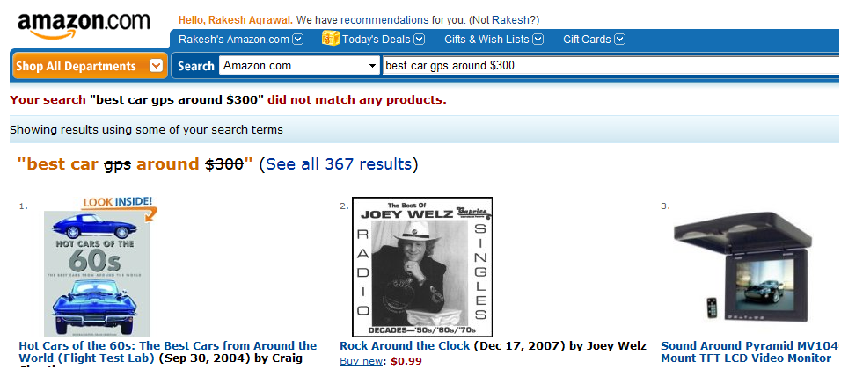
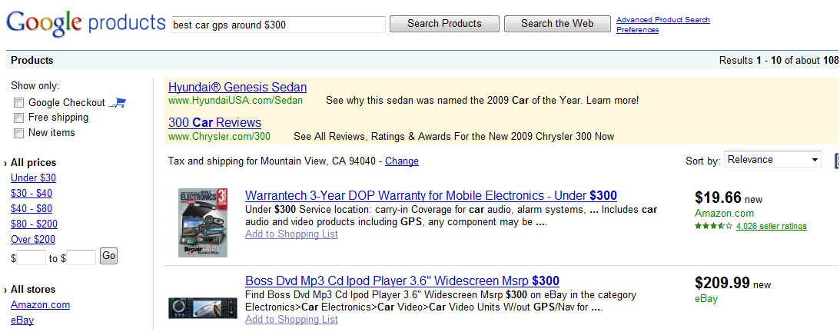
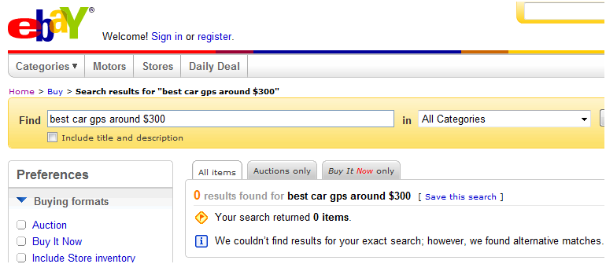
Notes:
Rich structure data → should do better
Failure of keyword approach & treating entities as documents
Lack of index-depth and diversity also means failure more obvious (there is only one Garmin Nuvi 500 – if you miss it, it’s gone)

Slide 6
Entity Search ≠ Web Search
Entity data has inherent structure
Entities have typed properties (brand, size, phone #, …)
Entities are often categorized into a taxonomy
Entity queries have semantics and implicit structure
Primary task of the user is often to make a decision (buying a product or service, making reservations, etc.)
Give users a sense of what is available
Tools to easily drill down and explore
Decision aids (reviews, recommendations, comparisons, when to buy, collaboration and sharing)
Notes:
Web search goals can often be satisfied in aggregate having viewed multiple pages
In entity search, goal is to ultimately identify the “best” single result from all the rest

Slide 7
Lincoln Project
Founded: March 3rd, 2009
Goal: Build a working end-to-end experimental commerce search engine
Proving grounds for new ideas
Build a best-of-breed catalog and user experience
Seamless integration with general web search

Slide 8
Outline
Lincoln Demo (screenshots)
Lincoln System
Runtime overview
Query processing details
Catalog overview
Extending Lincoln to the Web
Open Challenges

Slide 9
Outline
Lincoln Demo (screenshots)
Lincoln System
Runtime overview
Query processing details
Catalog overview
Extending Lincoln to the Web
Open Challenges

Slide 10
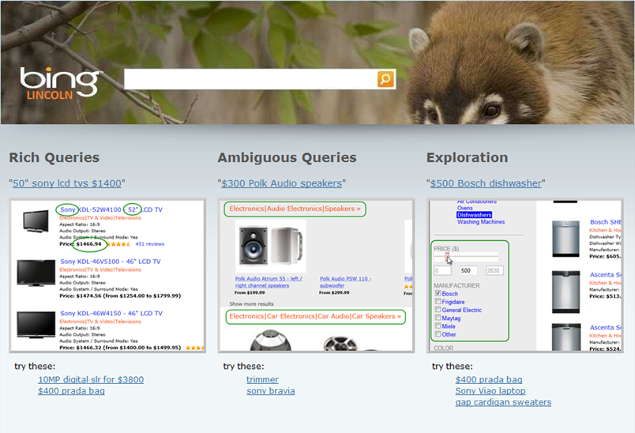
Seamless Integration with Web Search
50” sony lcd tv $1400
Commercial Intent?
Web Search
Commerce Search

Slide 11
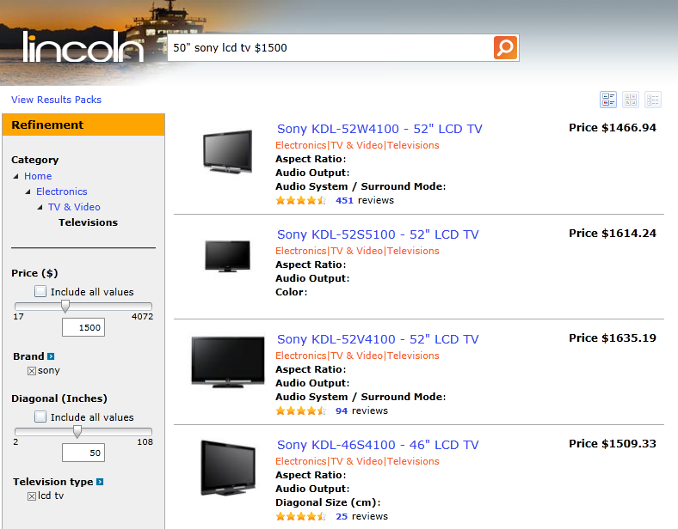
Lincoln Search Results
Notes:
Focusing first on the results: Lincoln understands the structure of the query and surfaced relevant results
Correctly identified type of products that the user wanted (TVs) – isn’t just results that happened to be most relevant, but category was detected and explicitly filtered
Recognized structure in the query (Brand, Size, Price and type)
Matched on structure, with approximate match on price and diagonal – point queries don’t work (Sony doesn’t make 50” lcd tvs, which many users probably don’t know)
However, we use query understanding for more than just finding relevant results…

Slide 12
Lincoln Search Results
Notes:
We also used semantics extracted from the query to initialize the refinements
Category browser selects most specific relevant category: Televisions
Show relevant refinements for the category (note, not manually selected), including all that were specified in query (e.g., show weight if it was queried)
We also initialize refinement controls with values
Query text and refinements stay in-sync at all times
Changing the refinements updates the query text (change price slider to 1000 updates query text to 50” sony lcd tv $1000)
Tight synchronization serves to teach the user to do rich queries (user starts with sony lcd tv and sees price added to query when price slider moved)

Slide 13
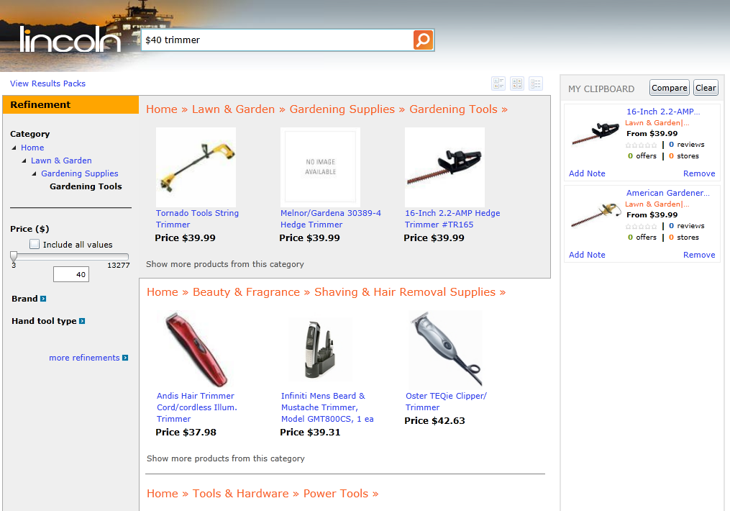
Lincoln – Ambiguous Queries
Notes:
We also handle ambiguity in intent quite differently than what continues to be common today
We understand that queries can be vague and map to more than one category (e.g., “$40 trimmer”)
However, we also understand that the user almost always has singular intent (true intent), even if query itself is vague (expressed intent)
So instead of intermixing results in single ranked list, call out relevant categories to the user and let them disambiguate
Note the refinements are initialized for the first “most likely” category

Slide 14
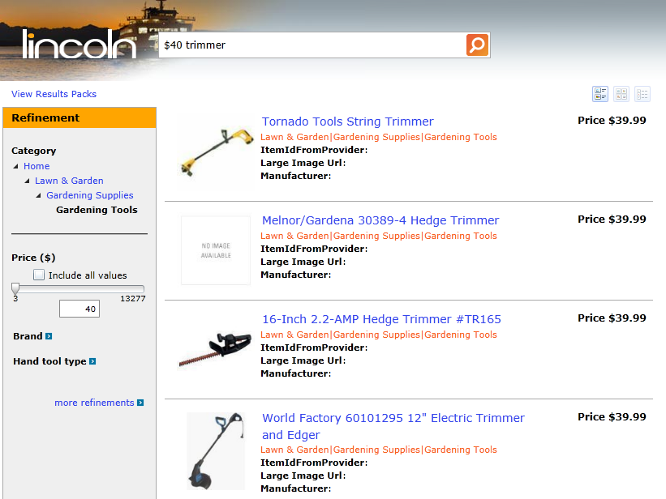
Lincoln – Ambiguous Queries
Notes:
Clicking on a category yields a full result set
Note that the keyword “trimmer” is treated as free text in this category

Slide 15
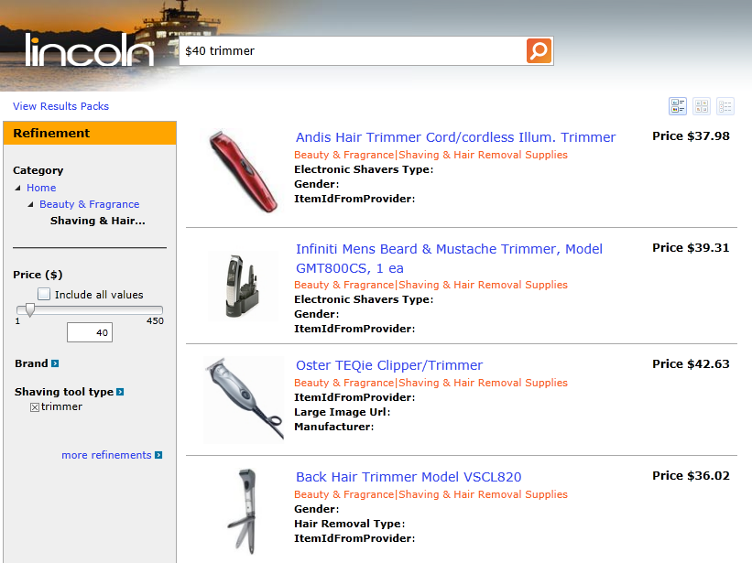
Lincoln – Ambiguous Queries
Notes:
For the other category, the keyword ‘trimmers’ is mapped to the category-specific attribute “Shaving tool type”

Slide 16
Outline
Lincoln Demo (screenshots)
Lincoln System
Runtime overview
Query processing details
Catalog overview
Extending Lincoln to the Web
Open Challenges

Slide 17
Runtime Components
Browser
HTTP Services
Custom Services
Silverlight UI
Custom Libraries
Query Analysis
Front Door
ProdCast
Data API
Commercial Intent
Entity DB
Content
Query Execution
Query Classification
Data API
Query Annotations
ISN
. . .
ISN
Notes:
used a service-oriented architecture to keep things flexible

Slide 18
Runtime Components
Browser
HTTP Services
Custom Services
Silverlight UI
Custom Libraries
Query Analysis Service
Query Analysis
Function:
Meta-service that invokes the individual query services and combines the results into a single QueryPack.
Front Door
ProdCast
Data API
Commercial Intent
Entity DB
Content Service
Query Execution
Query Classification
Data API
Query Annotations
ISN
. . .
ISN

Slide 19
Runtime Components
Browser
HTTP Services
Custom Services
Silverlight UI
Custom Libraries
Commercial Intent Service
Query Analysis
Function:
Determine if query is a commercial query (user is looking for products, not web results).
Citations:
KDD’09
Front Door
ProdCast
Data API
Commercial Intent
Entity DB
Content
Query Execution
Query Classification
Data API
Query Annotations
ISN
. . .
ISN

Slide 20
Runtime Components
Browser
HTTP Services
Custom Services
Silverlight UI
Custom Libraries
Query Classification Service
Query Analysis
Function:
Associates the query with one or more categories, each with a probability score.
Front Door
ProdCast
Data API
Commercial Intent
Entity DB
Content
Query Execution
Query Classification
Data API
Query Annotations
ISN
. . .
ISN

Slide 21
Runtime Components
Browser
HTTP Services
Custom Services
Silverlight UI
Custom Libraries
Query Annotations Service
Query Analysis
Function:
Extracts structure from the query, identifying things like brand, price, and category-specific attributes like screen-diagonal. Also creates structured predicates used by Query Execution.
Citations:
SIGMOD’09
SIGMOD’10
Front Door
ProdCast
Data API
Commercial Intent
Entity DB
Content
Query Execution
Query Classification
Data API
Query Annotations
ISN
. . .
ISN

Slide 22
Runtime Components
Browser
HTTP Services
Custom Services
Silverlight UI
Custom Libraries
Query Execution Service
Query Analysis
Function:
Executes the query, matching and ranking products to return to the user. Uses structure in addition to text & static features.
Citations:
WSDM’11
WWW’11
CIKM’11
Front Door
ProdCast
Data API
Commercial Intent
Entity DB
Content
Query Execution
Query Classification
Data API
Query Annotations
ISN
. . .
ISN

Slide 23
Runtime Components
Browser
HTTP Services
Custom Services
Silverlight UI
Custom Libraries
Content Service
Query Analysis
Function:
Intermediary for Query Execution service. Primary role is to fetch and return display data to the UI for the entity IDs returned by the Query Execution service.
Citations:
SIGMOD’11
Front Door
ProdCast
Data API
Commercial Intent
Entity DB
Content
Query Execution
Query Classification
Data API
Query Annotations
ISN
. . .
ISN

Slide 24
Runtime Components
Browser
HTTP Services
Custom Services
Silverlight UI
Custom Libraries
ProdCast Service
Query Analysis
Function:
Returns the historical pricing and price-trend prediction for a given product.
Citations:
KDD’11
CIKM’11
KDD’12
Front Door
ProdCast
Data API
Commercial Intent
Entity DB
Content
Query Execution
Query Classification
Data API
Query Annotations
ISN
. . .
ISN

Slide 25
Runtime Components
Browser
HTTP Services
Custom Services
Silverlight UI
Custom Libraries
Front Door Service
Query Analysis
Front Door
Function:
Coordinates query execution and other data requests (offers, price history & forecasting, product reviews) for the user interface.
ProdCast
Data API
Commercial Intent
Entity DB
Content
Query Execution
Query Classification
Data API
Query Annotations
ISN
. . .
ISN

Slide 26
QueryPack
Captures everything we can intuit about a query, and how it should be interpreted
Contains:
Literal query text typed by the user
General intent inferred from the query
User Intent – commercial / non-commercial with probability score
Query categorization – multiple categories with probability scores
Structure extracted from the query
Zero or more structured interpretations
Each interpretation is tied to a category
Annotations mapping of query tokens to typed attribute values
Structured filter predicates on attributes based on annotations

Slide 27
Sample QueryPack XML
Query: sony 52” lcd tv
<querypack source="QUERYANALYSIS" guid="bf14017c-70a8-4444-8c10-68bb03e7668b">
<literal>sony 52" lcd tv</literal>
<structuredhints id="1" categoryids="4724">
<annotation score="-5.22" tablename="Televisions" tableid="4724">
<tc id="1523" name="manufacturer">sony</tc>
<tc id="753" name="diagonal size (cm)" unit="&quot;">52</tc>
<tc id="2667" name="television type">lcd tv</tc>
</annotation>
<structuredops>
<AND>
<FILTER attrname="category" attrid="100002" op="EQ" value="Televisions@@4724" />
<FILTER attrname="manufacturer" attrid="1523" op="EQ" value="sony" />
<FILTER attrname="diagonal size" attrid="753" op="FUZZYEQ" value="52" unit="&quot;" />
<FILTER attrname="television type" attrid="2667" op="EQ" value="lcd tv" />
</AND>
</structuredops>
</structuredhints>
<metadata>
<intent value="commercial" score="1.00" />
<categories>
<category id="4724" name="Electronics (0.94)|TV &amp; Video (0.87)|Televisions (0.73)" />
</categories>
</metadata>
</querypack>

Slide 28
ResultsPacks
Captures the results of a query execution
Contains:
Literal query typed by the user
Original QueryPack passed to query execution service
Result sets containing ranked results:
Zero or more result sets
Each result set corresponds to single category
Each result set contains:
An ordered set of one or more scored results
Identification of the category results belong to
Simple QueryPack representing query actually executed

Slide 29
Sample QueryPack XML (2)
Query: $200 polk audio speakers
<querypack source="QUERYANALYSIS" guid="de8e2d78-af76-47c8-ad53-2a9aee8aa172">
<literal>$200 polk audio speakers</literal>
<structuredhints id="1" categoryids="4646">
<annotation score="-5.29" tablename="Speakers" tableid="4646" .../>
<structuredops .../>
</structuredhints>
<structuredhints id="2" categoryids="4674">
<annotation score="-14.03" tablename="Car Speakers" tableid="4674" .../>
<structuredops .../>
</structuredhints>
<metadata>
<intent value="commercial" score="1.00" />
<categories>
<category id="4646" name="Electronics (0.82)|Audio Electronics (0.46)|Speakers (0.37)"/>
<category id="4674" name="Electronics (0.82)|Car Electronics (0.33)|Car Audio (0.22)|Car Speakers (0.19)"/>
</categories>
</metadata>
</querypack>

Slide 30
Sample ResultsPacks XML
Query: $200 polk audio speakers
<ResultsPacks>
<Query>$200 polk audio speakers</Query>
<querypack source="QUERYANALYSIS" guid="de8e2d78-af76-47c8-ad53-2a9aee8aa172" .../>
<ResultsPack CategoryId="4646">
<Results TotalResults="10">
<Result type="product" id="328682" position="1" relevance="56.81777" categoryid="4646">
<Attribute name="ProductTitle">polk audio monitor 70 - speakers</Attribute>
</Result>
<Result type="product" id="247331" position="2" relevance="56.02646" categoryid="4646">
<Attribute name="ProductTitle">polk audio atrium 45 - speakers</Attribute>
</Result>
...
</Results>
<querypack>
<literal>$200 polk audio speakers</literal>
<structuredhints id="1" categoryids="4646" .../>
<metadata>
...
<category id="4646" name="Electronics (0.82)|Audio Electronics (0.46)|Speakers (0.37)"/>
...
</metadata>
</querypack>
</ResultsPack>
<ResultsPack CategoryId="4674" .../>
</ResultsPacks>

Slide 31
Data Flow – User Query
Silverlight UI
query
Query Analysis
Front Door
ProdCast
Query Pack
Data API
query
query
query
Commercial Intent
Query Pack
Entity DB
Content
Query Execution
Query Classification
Display Content
Results Packs
Results Packs
Query Pack
Data API
Query Annotations
Query Pack
ISN
. . .
ISN

Slide 32
Data Flow – UI Refinement
Adjusts Refinements
Silverlight UI
Query Pack
Query Analysis
Front Door
ProdCast
Data API
Commercial Intent
Entity DB
Content
Query Execution
Query Classification
Display Content
Results Packs
Results Packs
Data API
Query Annotations
ISN
. . .
ISN

Slide 33
Outline
Lincoln Demo (screenshots)
Lincoln System
Runtime overview
Query processing details
Catalog overview
Extending Lincoln to the Web
Open Challenges

Slide 34
Query Classification
Silverlight UI
Query Analysis
Front Door
ProdCast
Data API
Commercial Intent
Entity DB
Content
Query Execution
Query Classification
Data API
Query Annotations
ISN
. . .
ISN

Slide 35
Query Classification Service
Given a query, find the most specialized and relevant categories, with probability scores
Return selected categories as a QueryPack
Challenges:
Queries can be vague and match multiple categories
There are too many categories for a single multi-class classifier (6000 node taxonomy)
Training data that reflects real user queries

Slide 36
Hierarchical Query Classification
Taxonomy tree traversal from root with pruning
Multi-class classifier from node to immediate children
Agnostic to classifier – require probability distribution
Quality/relevance score of a node is the product of probabilities from node to root
Stop when quality score falls below threshold τ (e.g. τ = 1/maximum # categories desired)
Yields ordered list of most specific categories above quality threshold → QueryPack
Notes:
helps with vague queries → only go as deep as needed

Slide 37
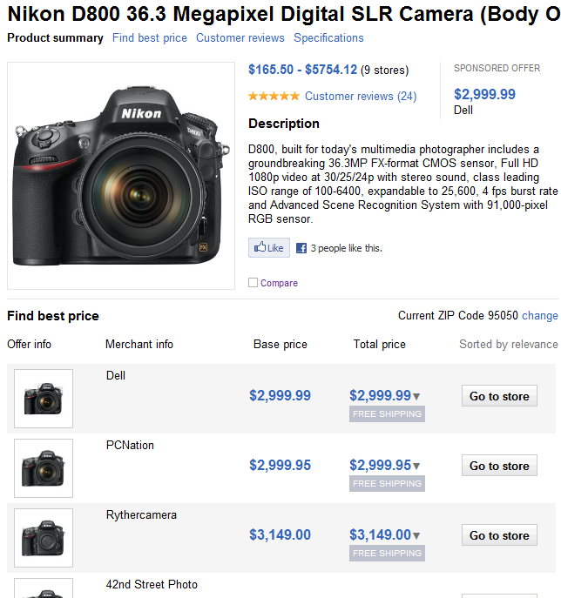
Harvesting Training Data
Leverage user signals
Query clicks is typically a strong relevance signal
In commerce, a purchase or intent to purchase is even stronger
Use “Go to store” clicks to link queries and products for training

Slide 38
Query Annotations
Silverlight UI
Query Analysis
Front Door
ProdCast
Data API
Commercial Intent
Entity DB
Content
Query Execution
Query Classification
Data API
Query Annotations
ISN
. . .
ISN

Slide 39
Query Annotation Service
Given a query, produce all relevant structured interpretations of the query with scores
Returns selected annotations in QueryPack
Observations:
Use the structured data to extract query structure
Need only recognize DB → closed-world model
Annotations reinforce each other
Un-annotated words can still help disambiguate

Slide 40
Generating and Scoring Annotations
Tagger to identify all possible annotations
Trie for categorics; Unit conversion for numerics
Annotation scoring to select most plausible
Generative model for queries
$Pr\left({annotation}_{c}\right)=Pr\left(T_{a}∪T_{text}|A_{c}\right)Pr\left(A_{c}\right)$ $⇒Pr\left(T_{a}|A_{c}\right)Pr\left(T_{text}|C\right)Pr\left(A_{c}\right)$
Model parameters estimated using structured-data statistics and via EM over web-queries
Notes:
Combined model of closed-world for structure (defined by DB) and open-world for text
Tagger built from entity data (closed-world model)
Generic unit-conversion for many measurements (length, quantity, time, volume)
Tagger produces all possible maximal annotations (such that no free-text mapping could be converted to a structured mapping)
Annotation is a mapping of each token to either free text or structure for a specific category
Scoring is based on generative model of query construction for a given category
Pr(annotation) = Pr(specific set of attributes is selected) * Pr(structured & free tokens given an attribute set)
Refactor the second term to get: Pr(specific set of attributes selected) * Pr(free tokens given category) * Pr(structure tokens given attribute set)
Pr(attribute set selected) = unsupervised learning via EM over sample query log, where maximize probability of generating query using any of the possible structured annotation or entirely open-world free-text.
Pr(free tokens given category) = unigram frequency model based on weighted combination of open world probability (generic query logs) and category probability (words from all attribute names & values in category)
Pr(structured tokens given category) = straight from occurrence stats in table (histograms for numerics – much literature on this, esp. in DB selectivity estimation work)

Slide 41
Insight into Scoring
Example query: “samsung 50 inch flat tv”
Samsung appears as Brand value for 20% of TVs
50 in falls in Diagonal bucket 48-52 for 25% of TVs
flat, tv both appear as frequent unigrams in the text of all TV entities
Brand and Diagonal are popular attributes that are commonly queried together for televisions
→ overall probability score uses all these ratios

Slide 42
Query Execution
Silverlight UI
Query Analysis
Front Door
ProdCast
Data API
Commercial Intent
Entity DB
Content
Query Execution
Query Classification
Data API
Query Annotations
ISN
. . .
ISN

Slide 43
Query Execution Service
Given a QueryPack with multiple structured annotations, find best and most-relevant results
Return results for each category in ResultsPack
Challenges
Distinction between matching, ranking and selection
Users may not know the domain, much less the DB
Must handle over-specified and ill-specified queries

Slide 44
Matching, Ranking & Selection
Matching
Cannot always match the query exactly (samsung 50” lcd tv)
Requires predicate relaxation (50” → 48-52”, lcd → plasma, led)
Leverage user signals for relaxation of categorical values
Ranking
Query has two components: text and structure
Structured relevance should take precedence over textual
Must also include domain relevance signals
Selection / Re-ranking
Among those top ranked results, it often helps to select those that represent diversity with regards to unspecified aspects
Selection helps ensure users see variety of matching entities
More engaging and potentially helps educate user on domain
Notes:
Matching/filtering
Point queries will very likely fail… relax predicates (numbers → ranges, categorical → set values, drop entirely)
Optimization framework to select at least K results within a bounded # of rewrites (performance criteria)
Ranking
Static relevance reflects the reputation/quality/importance of the object in the domain, irrespective of any query
In web search, static relevance is based on signals like PageRank, spam/junk scores, page visits and clicks, etc.
Re-ranking
Must cover queries attributes, but show variation in non-queried attributes (range of prices, range of brands, etc.)
Frame as Max-Sum dispersion problem
Fixed budget where cost of result is inversely proportional to relevance
Maximize the sum of pair-wise distances in non-queried attributes

Slide 45
Ranking Function
Ranking components
Text Relevance – TR(q,e)
BM25F & SPAN metrics over Brand, Category, Name, …
Structure Relevance – SR(q,e)
$SR\left(q,e\right)=\sum_{i=1}^{k}{w^{i}\left(1−\frac{\left|q.value−e.value\right|}{e.value}\right)}$
Domain Relevance – DR(e)
Relevance of the entity to the domain, independent of query
# of reviews/offers, sales volume, page views, rating, …
Ranking Function:
$score\left(q,e\right)=DR\left(e\right){TR\left(q,e\right)}^{1−W/k}SR\left(q,e\right)$
Notes:
Ranking function at ISN combines 3 components: textual relevance, structural relevance and domain relevance
Textual relevance based on BM25F and proximity features (SPAN) against textual fields (standard IR text features)
Structural match is based on value distance, weighed by attribute importance (inferred from queries)
Categorical distance determined from on query browse trails (HP close to Canon in Printers, but not in Cameras)
Combined function
Gracefully tradeoff between structural match and text. More structure identifies, less weight given to textual relevance

Slide 46
Outline
Lincoln Demo (screenshots)
Lincoln System
Runtime overview
Query processing details
Catalog overview
Extending Lincoln to the Web
Open Challenges

Slide 47
Lincoln Catalog Overview
Weekly Product Feeds
Delta computation
Typing
Classification
Image Fetcher
Product Synthesis
Product Database
Product Price History
Unmatched offers
Matching
Daily Offer Feeds
Delta computation
Classification
Offer Database
Product-Offer Matches

Slide 48
Lincoln Catalog Overview
Weekly Product Feeds
Classification
Delta computation
Typing
Classification
Function:
Classifies new offers and products to the taxonomy, leveraging title text, source taxonomy & image similarity.
Citations:
TKDE’10
ICDM’11
Image Fetcher
Product Synthesis
Product Database
Product Price History
Unmatched offers
Matching
Daily Offer Feeds
Delta computation
Classification
Offer Database
Product-Offer Matches
Notes:
Similar textual classifier as queries (Offers are basically title & description)
Also, leverage any available source-feed taxonomy info (items close in source taxonomy should be close in our taxonomy)
Also leverage image similarity to category (e.g., helps separate accessories from main products)

Slide 49
Lincoln Catalog Overview
Weekly Product Feeds
Offer Matching
Delta computation
Typing
Classification
Function:
Matches offers to structured product records, leveraging implicit structure in offer titles. Category-specific scoring model determines most likely interpretation of structure
Citations:
KDD’11
MAPREDUCE’11
Image Fetcher
Product Synthesis
Product Database
Product Price History
Unmatched offers
Matching
Daily Offer Feeds
Delta computation
Classification
Offer Database
Product-Offer Matches
Notes:
Similar inspiration as with query annotations, but applied to titles
Titles tend to contain values for key attributes
Looks to find most likely interpretation, where interpretation is tied to specific product (not category)
A key idea is no match and mis-match are distinguished (mis-match is more serious)

Slide 50
Lincoln Catalog Overview
Weekly Product Feeds
Product Synthesis
Delta computation
Typing
Classification
Function:
Clusters unmatched offers and extracts a structured product record from each cluster. Leverages the structured HTML pages from the merchant URLs.
Citations:
WWW’11
VLDB’11
Image Fetcher
Product Synthesis
Product Database
Product Price History
Unmatched offers
Matching
Daily Offer Feeds
Delta computation
Classification
Offer Database
Product-Offer Matches
Notes:
Use unmatched offers as source for new products
New products often appear in offer feeds before products
Offers unstructured (can’t easily create product from them), but landing page often has table rich with specs
Cluster similar offers (about same product) and extract structure from multiple pages (redundancy)
Learn mappings from known matches from that merchant

Slide 51
Outline
Lincoln Demo (screenshots)
Lincoln System
Runtime overview
Query processing details
Catalog overview
Extending Lincoln to the Web
Open Challenges

Slide 52
Entity Search on the Web
Entity queries simultaneously target both page content and entity properties
“best gps around $300”
“10MP digital camera reviews”
Need to combine these two datasets together
Join entity data with web data
Enrich web pages with clean, typed entity data
Notes:
search terms target both entity data and web content
In entity catalogs, data being searched over are direct representations of entities being queried
In web catalogs, data being search over are documents about entities being queried
Entity properties being queried may not appear on the web page – and user doesn’t necessarily care if they do (these terms are for entity relevance, not page relevance)
A great result for “best gps around $300” shouldn’t require that the token “$300” be anywhere on the page, so long as the entity discussed is around $300
Solution is to join the two datasets together so both sources of data can be matched to the query

Slide 53
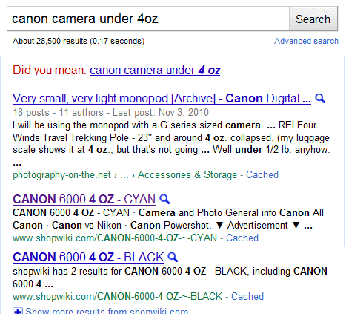
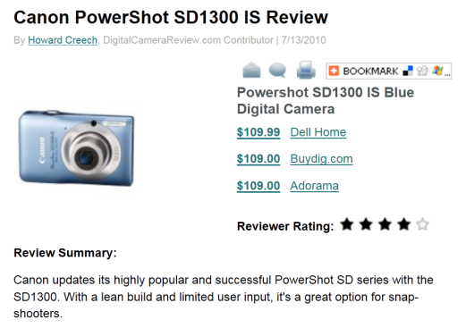
Enriching Documents with Entities
canon camera under 4 oz
Unique combination of values that identify an entity → Trait
Learn traits from data base and use to score entities in documents
Enrich document with structured entity data
Query match against both structured data and text
Notes:
Need a join key: Traits
Traits are “fingerprints” for entities
Entities can have more than one trait… traits are also instance-based, not schema-based like DB keys
Presence of additional attribute values and terms contribute to scoring

Slide 54
Open Challenges
More to semantics than structure
Entity search is a process
Can span multiple sessions & days
Distinct phases requiring different experience
User Interface
As systems becomes more complex, can we keep the interface intuitive? Need new paradigms?
Explainability… why did you show me this?
Ultimately, search should not be siloed
Web and structured entity data support each other
Search must smoothly blend web and entity content

Slide 55
Thank You!
Panayiotis Tsaparas
Sreenivas Gollapudi
Krishnaram Kenthapadi
Samuel Ieong
Ariel Fuxman
Rakesh Agrawal
Anitha Kannan
Stelios Paparizos
John Shafer
Nina Mishra
Livia Polanyi

Slide 56
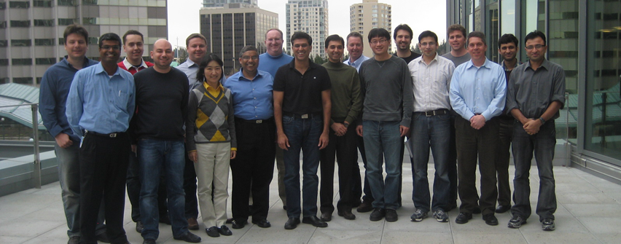
Bing Partnership
Radek Szamrej
Scott Thurlow
Angus Cunningham
Prakash Sikchi
Manish Mittal
Donna Liu
Rajat Taneja
Arun Sacheti
Notes:
Not Pictured: Saurab Nog, Daniel Keller, Gary Wiseman & many, many others

